Slide 1
COM4012M – JSON
Week 11 Lab Session 11

Slide 2
JSON
JSON stands for JavaScript Object Notation
JSON is "self-describing" so it is easy to read, write and understand for humans as it is a text format that is completely language independent, but still uses conventions of other programming languages.
JSON is a lightweight data-interchange format for storing and transporting data, which makes it an ideal data-interchange language.
It is often used when data is sent from a server to a web page.

Slide 3
JSON
JSON is built on two structures:
A collection of name/value pairs. In various languages, this is realized as an object, record, struct, dictionary, hash table, keyed list, or associative array.
An ordered list of values. In most languages, this is realized as an array, vector, list, or sequence.

Slide 4
JSON Example
This example is a JSON string:
'{"name":"John", "age":30, "car":null}’
It defines an object with 3 properties:
name
age
car
Each property is also given a value, which if you parse the JSON string you can access the object like so:
let personName = obj.name;

Slide 5
Why Use JSON
When you want to transfer data from one computer to another or from one program to another, then both ends have to agree on a format for that data. JSON is just one possible way to store the data as a text file. Others include XML, CSV, and plain text.
The JSON format specifically is syntactically similar to the code for creating JavaScript objects. Because of this, a JavaScript program can easily convert JSON data into JavaScript objects.

Slide 6
JSON vs XML
JSON Version
{"employees":[
{ "firstName":"John", "lastName":"Doe" },
{ "firstName":"Anna", "lastName":"Smith" },
{ "firstName":"Peter", "lastName":"Jones" }
]}
XML Version
<employees>
<employee>
<firstName>John</firstName> <lastName>Doe</lastName>
</employee>
<employee>
<firstName>Anna</firstName> <lastName>Smith</lastName>
</employee>
<employee>
<firstName>Peter</firstName> <lastName>Jones</lastName>
</employee>
</employees>

Slide 7
JSON vs XML
JSON is Like XML Because
Both JSON and XML are "self-describing" (human readable)
Both JSON and XML are hierarchical (values within values)
Both JSON and XML can be parsed and used by lots of programming languages
Both JSON and XML can be fetched with an XMLHttpRequest
JSON is Unlike XML Because
JSON doesn't use end tag
JSON is shorter
JSON is quicker to read and write
JSON can use arrays

Slide 8
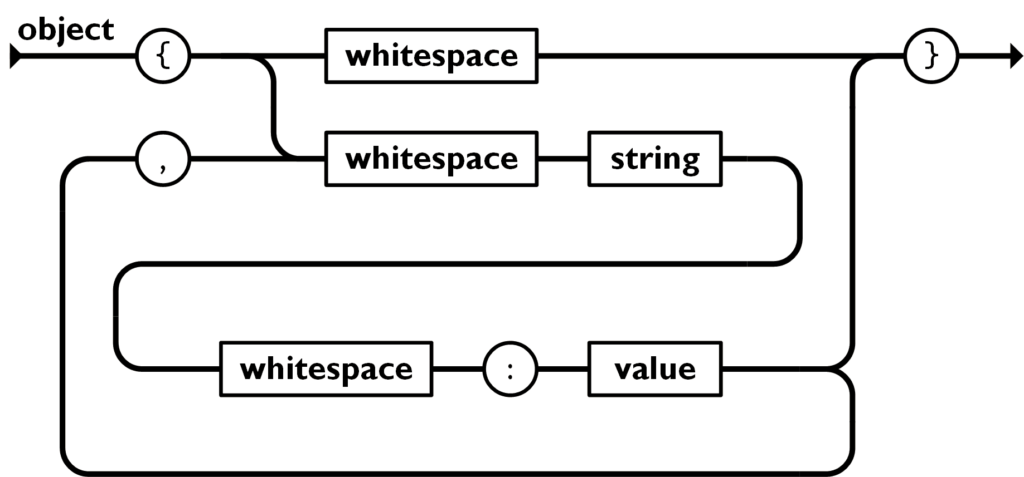
JSON Forms - Object
JSON can take on several forms. The first of which was an object.
An object is an unordered set of name/value pairs. An object begins with {left brace and ends with }right brace. Each name is followed by :colon and the name/value pairs are separated by ,comma.
{"name":"John", "age":30, "car":null}

Slide 9
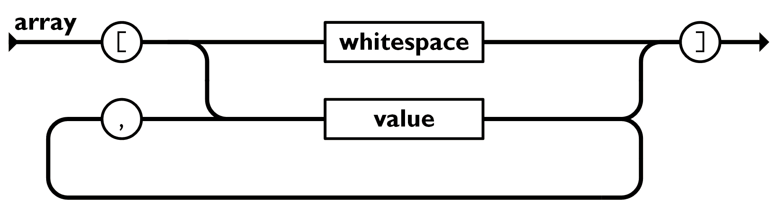
JSON Forms - Array
An array is an ordered collection of values. An array begins with [left bracket and ends with ]right bracket. Values are separated by ,comma.
const cars = ["Saab", "Volvo", "BMW"];

Slide 10
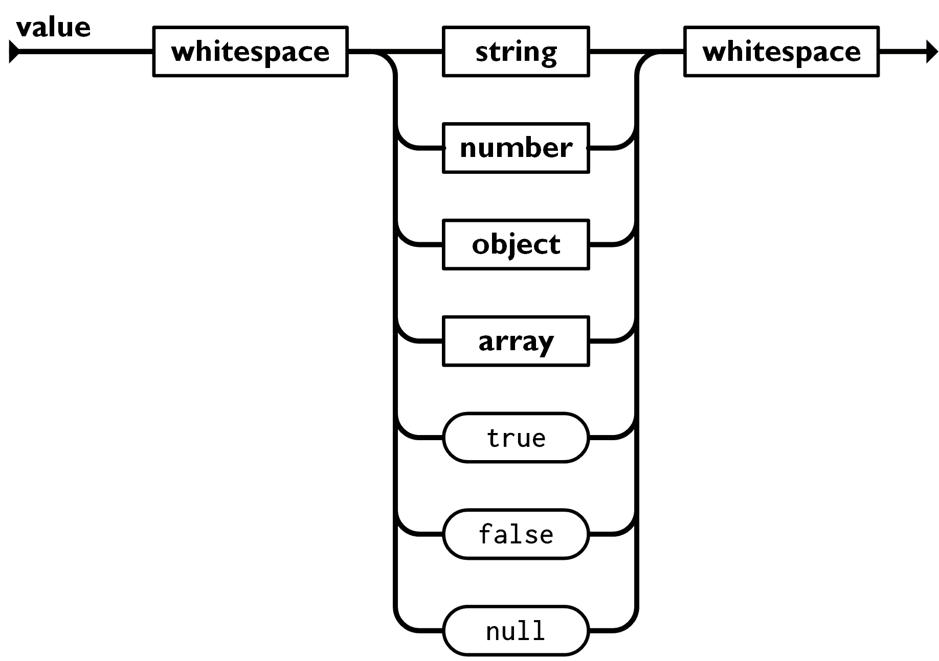
JSON Forms - Value
A value can be a string in double quotes, or a number, or true or false or null, or an object or an array. These structures can be nested.

Slide 11
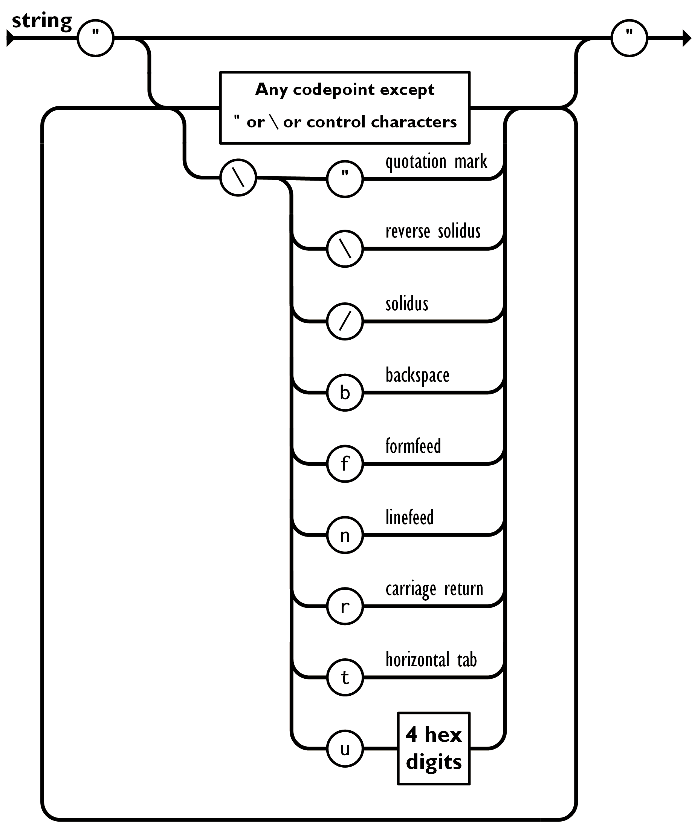
JSON Forms - String
A string is a sequence of zero or more Unicode characters, wrapped in double quotes, using backslash escapes. A character is represented as a single character string. A string is very much like a C or Java string.

Slide 12
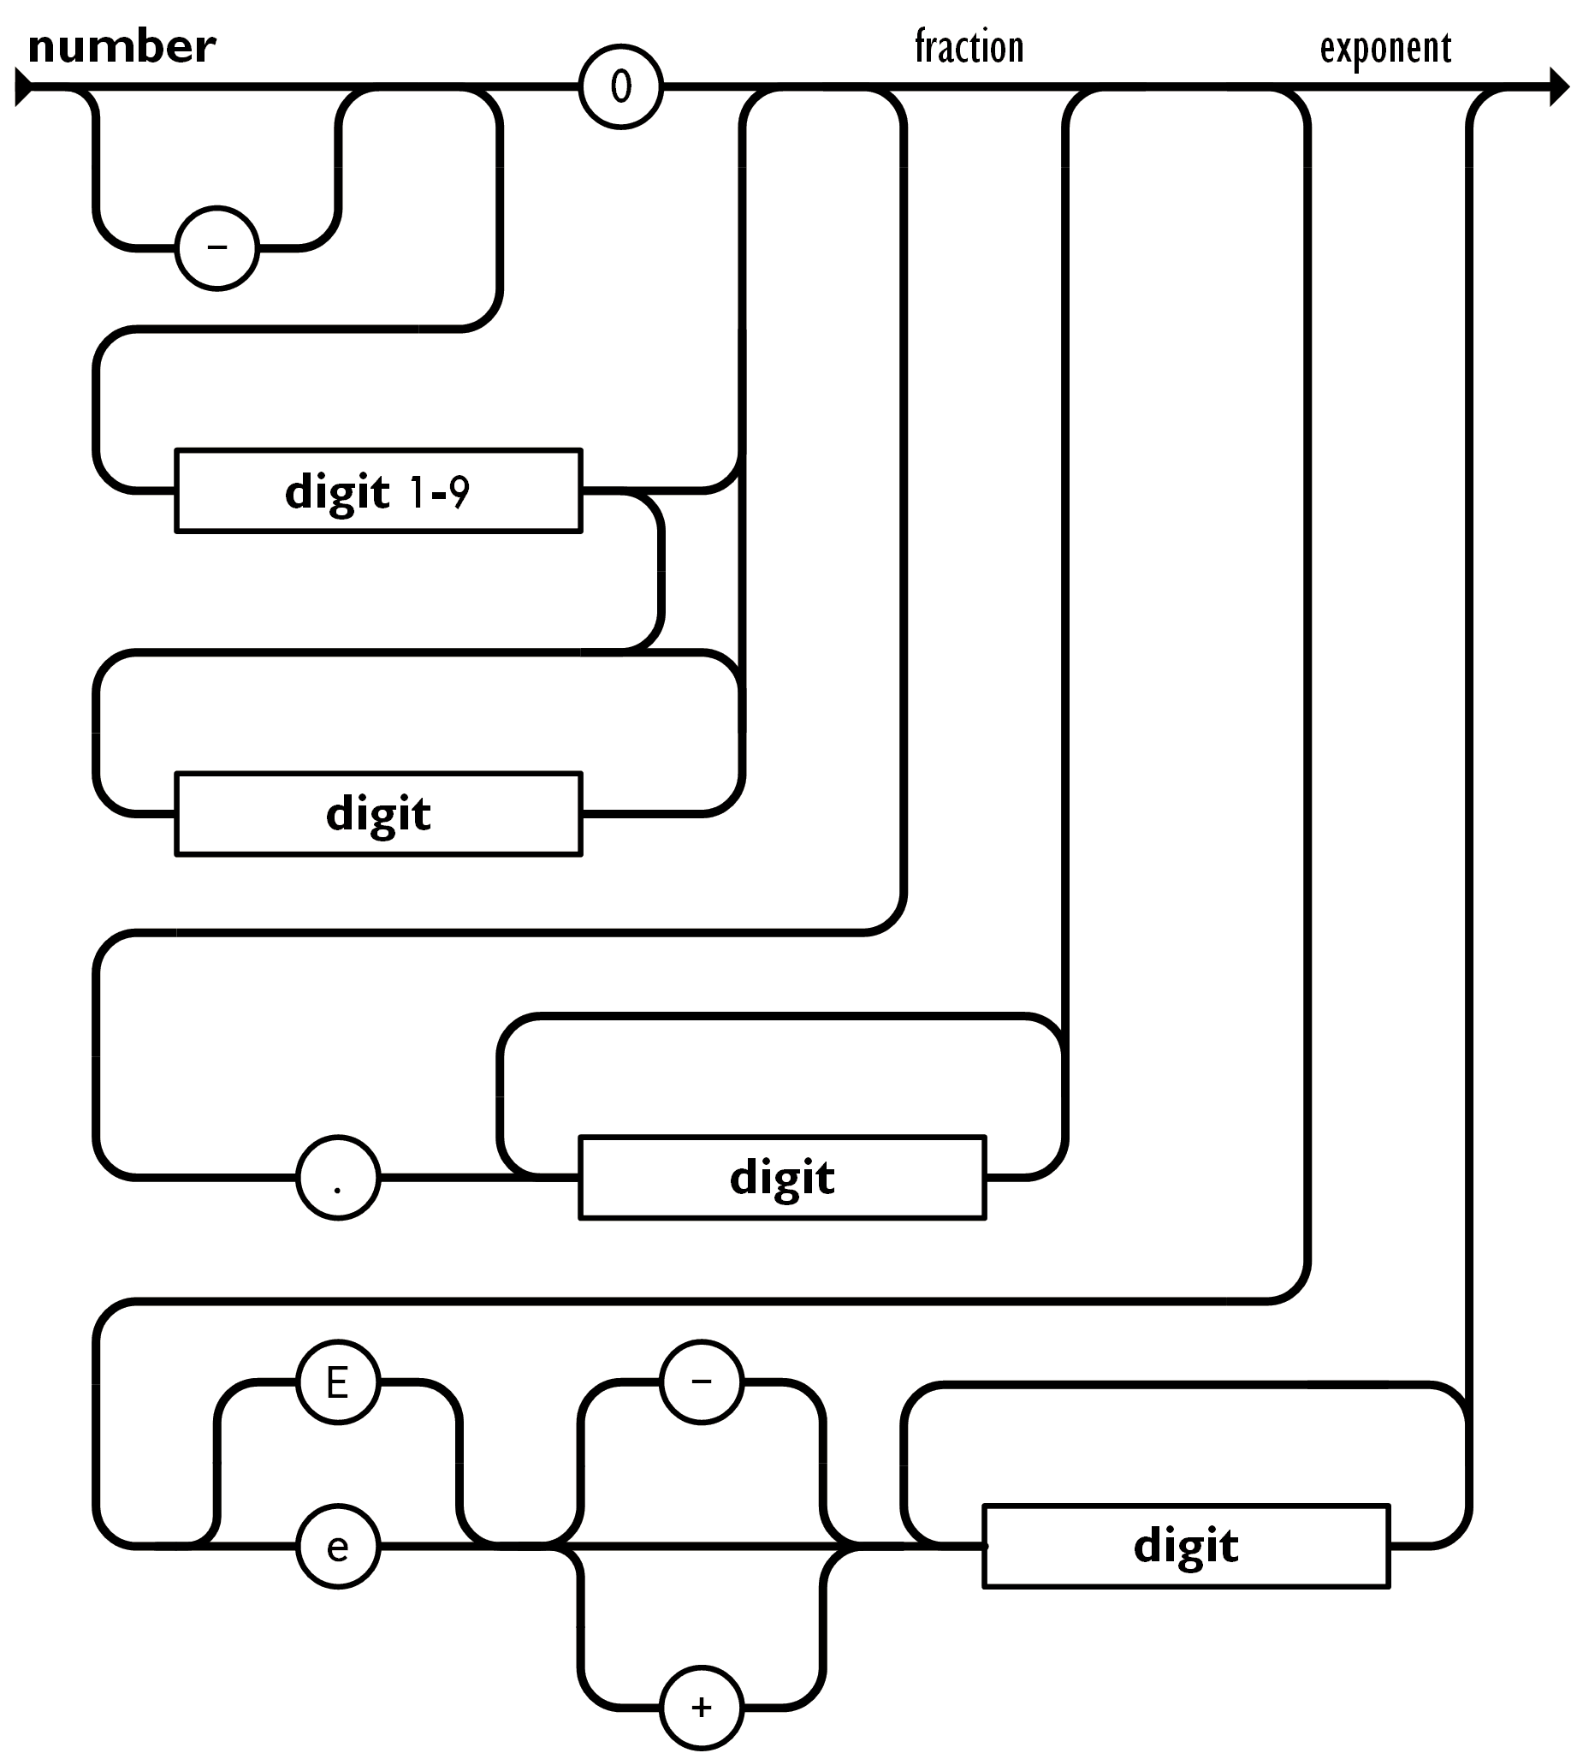
JSON Forms - Number
A number is very much like a C or Java number, except that the octal and hexadecimal formats are not used.

Slide 13
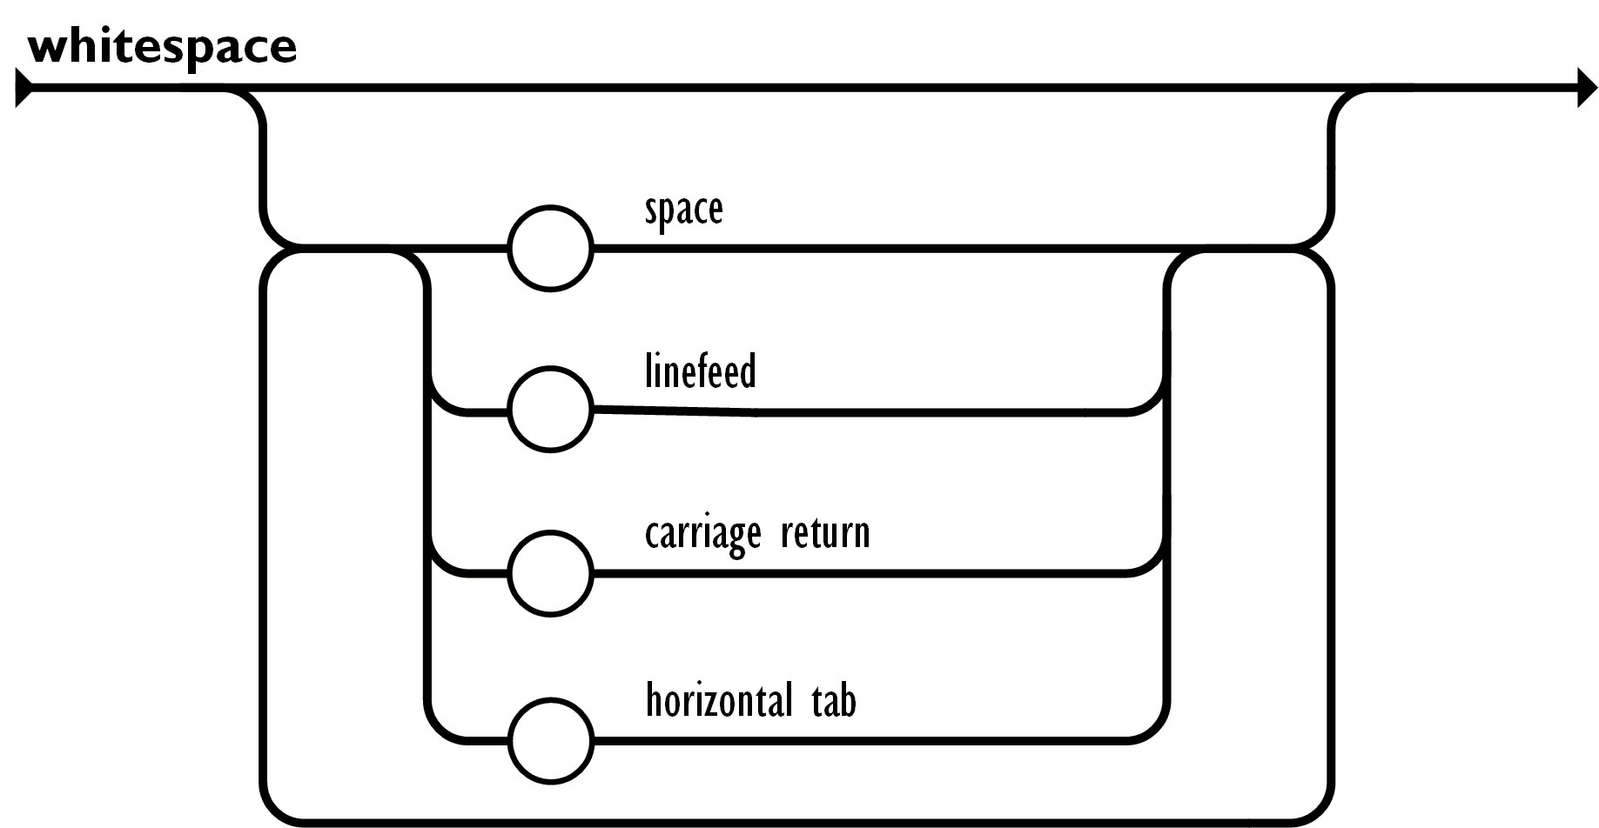
JSON Forms - Whitespace
Whitespace can be inserted between any pair of tokens. Excepting a few encoding details, that completely describes the language.

Slide 14
Receiving JSON
A common use of JSON is to exchange data to/from a web server. When receiving data from a web server, the data is always a string.
Imagine we received this text from a web server:
'{"name":"John", "age":30, "city":"New York"}’
Use the JavaScript function JSON.parse() to convert text into a JavaScript object:
const obj = JSON.parse('{"name":"John", "age":30, "city":"New York"}’);
You can then use it on your page like so:
<script>
document.getElementById("demo").innerHTML = obj.name;
</script>

Slide 15
Sending JSON
A common use of JSON is to exchange data to/from a web server. When sending data from a web server, the data is also always a string.
Imagine we have this object in JavaScript:
const obj = {name: "John", age: 30, city: "New York"};
Use the JavaScript function JSON.stringify() to convert it into a string:
const myJSON = JSON.stringify(obj);
Now that myJSON is a string, it is ready to be sent to a server:
const obj = {name: "John", age: 30, city: "New York"};
const myJSON = JSON.stringify(obj);

Slide 16
JSON with a Server
You can request JSON from the server by using an AJAX request. As long as the response from the server is written in JSON format, you can parse the string into a JavaScript object.
Use the XMLHttpRequest to get data from the server:
const xmlhttp = new XMLHttpRequest();
xmlhttp.onload = function() {
const myObj = JSON.parse(this.responseText);
document.getElementById("demo").innerHTML = myObj.name;
};
xmlhttp.open("GET", "json_demo.txt");
xmlhttp.send();

Slide 17
JSON with PHP
Objects in PHP can be converted into JSON by using the PHP function json_encode():
PHP file:
<?php
$myObj->name = "John";
$myObj->age = 30;
$myObj->city = "New York";
$myJSON = json_encode($myObj);
echo $myJSON;
?>

Slide 18
JSON with PHP
Here is a JavaScript on the client, using an AJAX call to request the PHP file from example before:
const xmlhttp = new XMLHttpRequest();
xmlhttp.onload = function() {
const myObj = JSON.parse(this.responseText);
document.getElementById("demo").innerHTML = myObj.name;
}
xmlhttp.open("GET", "demo_file.php");
xmlhttp.send();

Slide 19
JSON with PHP Database
Imagine you have a database on your server, and you want to send a request to it from the client where you ask for the 10 first rows in a table called "customers".
On the client, make a JSON object that describes the numbers of rows you want to return.
Before you send the request to the server, convert the JSON object into a string and send it as a parameter to the url of the PHP page like so:

Slide 20
JSON with PHP Database
Use JSON.stringify() to convert the JavaScript object into JSON:
const limit = {"limit":10};
const dbParam = JSON.stringify(limit);
xmlhttp = new XMLHttpRequest();
xmlhttp.onload = function() {
document.getElementById("demo").innerHTML = this.responseText;
}
xmlhttp.open("GET","json_demo_db.php?x=" + dbParam);
xmlhttp.send();
The above example defines an object containing a "limit" property and value.
It then converts the object into a JSON string.
It then sends a request to the PHP file, with the JSON string as a parameter.
It will wait until the request returns with the result (as JSON).
Finally, it displays the result received from the PHP file.

Slide 21
JSON with PHP Database
Use JSON.stringify() to convert the JavaScript object into JSON:
<?php
header("Content-Type: application/json; charset=UTF-8");
$obj = json_decode($_GET["x"], false);
$conn = new mysqli("myServer", "myUser", "myPassword", "Northwind");
$stmt = $conn->prepare("SELECT name FROM customers LIMIT ?");
$stmt->bind_param("s", $obj->limit);
$stmt->execute();
$result = $stmt->get_result();
$outp = $result->fetch_all(MYSQLI_ASSOC);
echo json_encode($outp);
?>
It first convert the request into an object, using the PHP function json_decode().
It then accesses the database and fills an array with the requested data.
It then adds the array to an object and returns the object as JSON using the json_encode() function.

Slide 22
jQuery
jQuery is a JavaScript library designed to simplify HTML DOM tree traversal and manipulation, as well as event handling, CSS animations, and Ajax.
jQuery, at its core, is a Document Object Model (DOM) manipulation library. The DOM is a tree-structure representation of all the elements of a Web page. jQuery simplifies the syntax for finding, selecting, and manipulating these DOM elements.

Slide 23
jQuery
The principles of developing with jQuery are:
Separation of JavaScript and HTML: The jQuery library provides simple syntax for adding event handlers to the DOM using JavaScript, rather than adding HTML event attributes to call JavaScript functions. Thus, it encourages developers to completely separate JavaScript code from HTML markup.
Brevity and clarity: jQuery promotes brevity and clarity with features like "chainable" functions and shorthand function names.
Elimination of cross-browser incompatibilities: The JavaScript engines of different browsers differ slightly so JavaScript code that works for one browser may not work for another. Like other JavaScript toolkits, jQuery handles all these cross-browser inconsistencies and provides a consistent interface that works across different browsers.
Extensibility: New events, elements, and methods can be easily added and then reused as a plugin.

Slide 24
jQuery
jQuery takes a lot of common tasks that require many lines of JavaScript code to accomplish and wraps them into methods that you can call with a single line of code.
The jQuery library contains the following features:
HTML/DOM manipulation
CSS manipulation
HTML event methods
Effects and animations
AJAX
Utilities
Tip: In addition, jQuery has plugins for almost any task out there.

Slide 25
Downloading jQuery
There are two versions of jQuery available for downloading:
Production version - this is for your live website because it has been minified and compressed
Development version - this is for testing and development (uncompressed and readable code)
Both can be found on jQuery.com
The jQuery library is a single JavaScript file, and you reference it with the HTML <script> tag (notice that the <script> tag should be inside the <head> section):
<head>
<script src="jquery-3.7.1.min.js"></script>
</head>

Slide 26
Downloading jQuery
If you don't want to download and host jQuery yourself, you can include it from a CDN (Content Delivery Network).
Google is an example of someone who host jQuery:
Google CDN:
<head>
<script src="https://ajax.googleapis.com/ajax/libs/jquery/3.7.1/jquery.min.js"></script>
</head>

Slide 27
jQuery Syntax
The jQuery syntax is tailor-made for selecting HTML elements and performing some action on the element(s).
Basic syntax is: $(selector).action()
A $ sign to define/access jQuery
A (selector) to "query (or find)" HTML elements
A jQuery action() to be performed on the element(s)
Examples:
$(this).hide() - hides the current element.
$("p").hide() - hides all <p> elements.
$(".test").hide() - hides all elements with class="test".
$("#test").hide() - hides the element with id="test".

Slide 28
jQuery Syntax
To prevent any jQuery code from running before the document is finished loading, it is good practice to wait for the document to be fully loaded. This also allows you to have your JavaScript code before the body of your document, in the head section.
Here are some examples of actions that can fail if methods are run before the document is fully loaded:
Trying to hide an element that is not created yet
Trying to get the size of an image that is not loaded yet
As such you should nest your jQuery methods inside a document ready event using 1 of the two methods
$(document).ready(function(){ or use: $(function(){
// jQuery methods go here...
});

Slide 29
jQuery Example
The jQuery element selector selects elements based on the element name.
You can select all <p> elements on a page like this:
$("p")
Example when a user clicks on a button, all <p> elements will be hidden:
$(document).ready(function(){
$("button").click(function(){
$("p").hide();
});
});

Slide 30
jQuery Event Examples
Click
$("p").click(function(){
$(this).hide();
});
Hover
$("#p1").hover(function(){
alert("You entered p1!");
},
function(){
alert("Bye! You now leave p1!");
});

Slide 31
Sourced
https://www.json.org/json-en.html
www.w3schools.com

